Slide 1


SAP UI5 & FIORI with OData TRAINING
Anubhav Oberoy
Day – 2

Slide 2

Agenda – Day 2
Introduction to the CSS
Why we use CSS
Introduction to Inline CSS
Introduction the Internal CSS
Introduction the External CSS
Understanding the Box Model in CSS
Introduction to JavaScript
Why we use JavaScript
Variable in JavaScript
Some Important point related to JavaScript
Methods to apply JS in HTML
Functions in JS
Synchronous and Asynchronous behavior in JS
Arrays and Object in JS
Changing the style element using JS

Slide 3

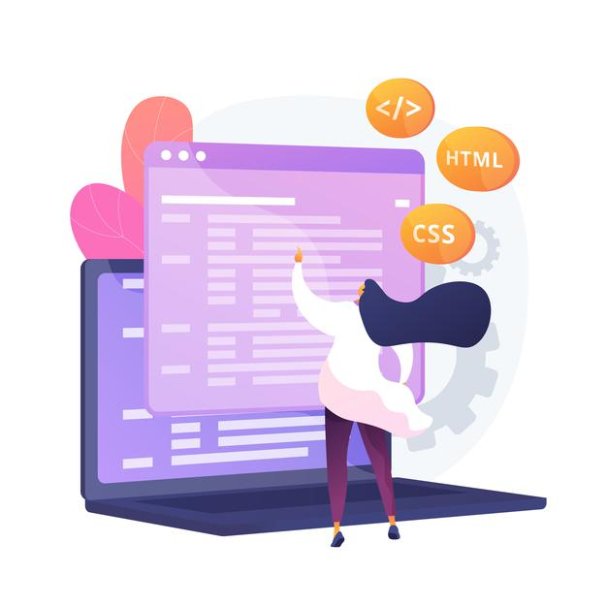
Introduction to CSS
CSS Stands for Cascading Style Sheets
CSS describes how HTML elements are to be displayed on screen, paper, or in other media.
CSS saves a lot of work. It can control the layout of multiple web pages all at once.
External stylesheet are stored in CSS file.
We need CSS because HTML can only generate static content w/o coloring, formatting, borders, beautification.
Ways of applying CSS in an HTML :-
01 Inline CSS
02 Internal CSS
03 External CSS
In Inline Style CSS is applied along with HTML Element
In Internal type the CSS is applied at the Page level
In External type the a separate CSS file is created and linked to the Page

Slide 4
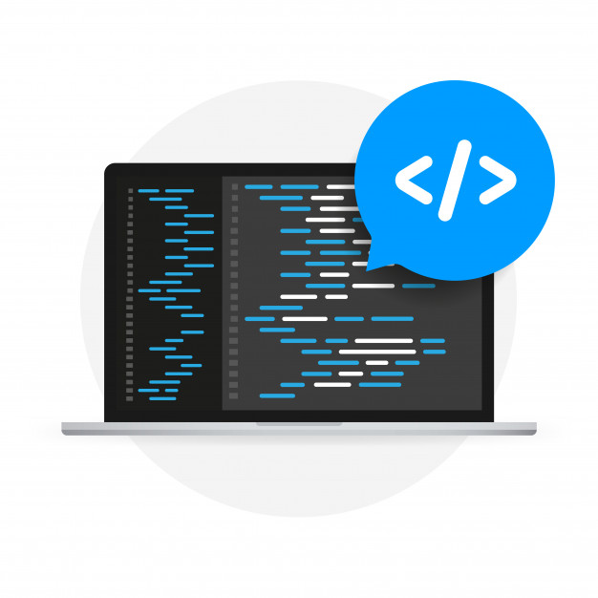
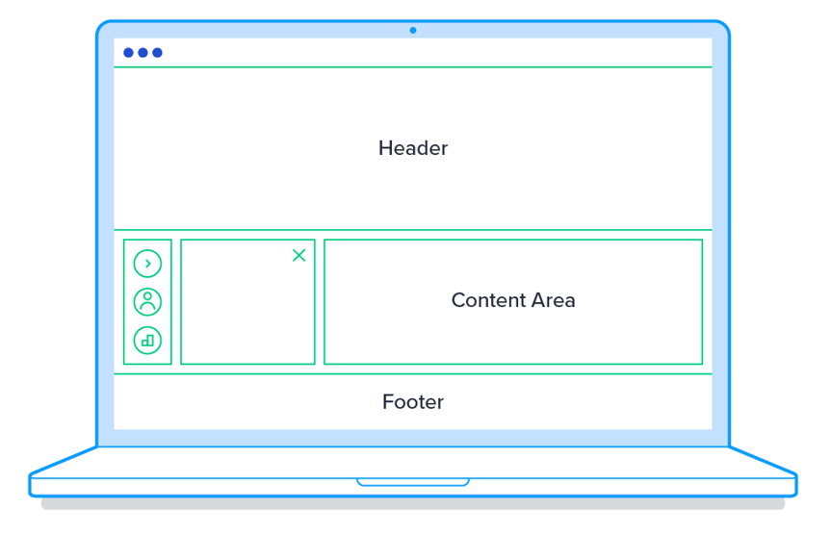
Why Use CSS
CSS helps we to keep the informational content of a document separate from the details of how to display it
The details of how to display the document are known as its style.
We keep the style separate from the content so that you can:
Avoid duplication
Make maintenance easier
Use the same content with different styles for different purposes
In general, you use HTML to describe the content of the document, not its style; you use CSS to specify its style, not its content.

Slide 5
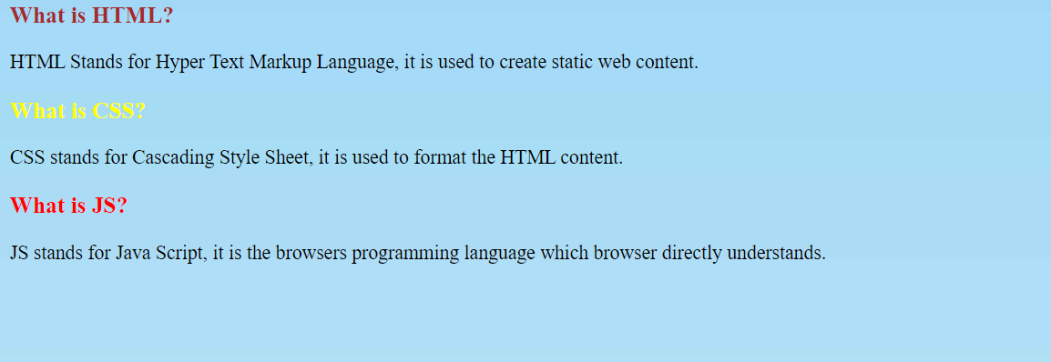
Inline CSS
Inline CSS: Inline CSS contains the CSS property in the body section attached with element is known as inline CSS. This kind of style is specified within an HTML tag using the style attribute.
We use a style attribute to assign CSS styling properties.
Inline styles in CSS could be useful for previewing changes instantly or adding CSS rules to only one or two elements. When you don't have access to your .css file, knowing how inline style CSS works can be convenient.
The following example sets the text color of the <h3> element to brown:
<div class="box-title">
<h3 style="color: brown;">What is HTML?</h3>
</div>
CSS Colors, Fonts and Sizes
The CSS color property defines the text color to be used
The CSS font-family property defines the font to be used.
The CSS font-size property defines the text size to be used.

Slide 6

Exercise: Inline CSS
Now we will understand how to apply CSS to html elements using the Inline method.
Exercise Code:
index.html
Bgimage.jpeg

Slide 7
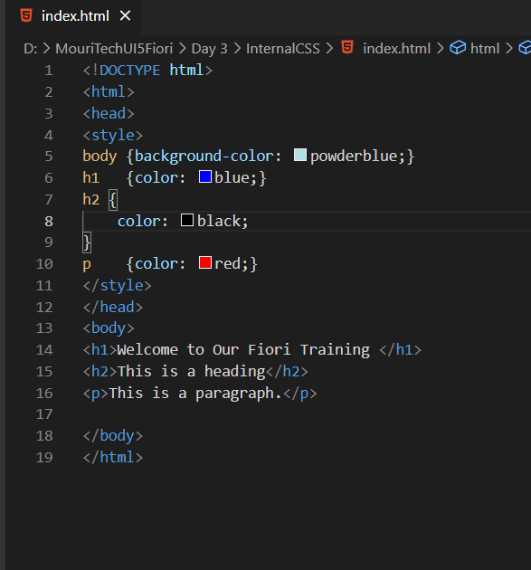
Internal CSS
Internal or Embedded CSS: This can be used when a single HTML document must be styled uniquely. The CSS rule set should be within the HTML file in the head section i.e. the CSS is embedded within the HTML file.
A Internal style sheet may be used if one single page has a unique style
Internal Style sheet are created using <style> element, which is added inside the <head> element of the HTML document.
You can define any number of <style> elements in an HTML document but they must appear between the <head> and </head> tags.
Syntax to Apply CSS in Internal mode
<style>
selector {
propertyname: value;
propname: value;
}
</style>

Slide 8

Exercise: Internal CSS
Now we will understand how to apply the CSS internally in the HTML file.
For that we will use the <style> tag in the <head> tag in the HTML.
Exercise Code/Resource:
index.html

Slide 9
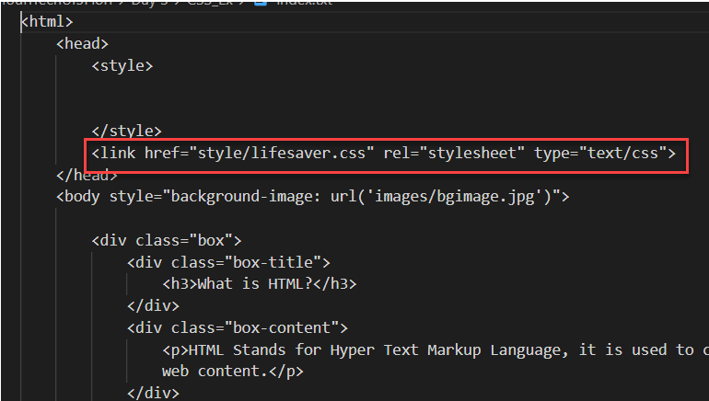
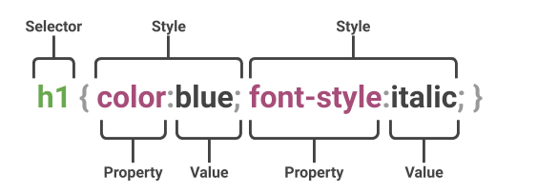
External CSS
External CSS: External CSS contains separate CSS file which contains only style property with the help of tag attributes (For example class, id, heading, … etc). CSS property written in a separate file with .css extension and should be linked to the HTML document using link tag. This means that for each element, style can be set only once and that will be applied across web pages.
You can attach external style sheets in two ways — linking and importing.
Define style sheet rules in a separate .css file and then include that file in your HTML document using HTML <link> tag.
Before linking, we need to create a style sheet first. Let's open your favorite code editor and create a new file. Now type the following CSS code inside this file and save it as "style.css".
An external style sheet can be linked to an HTML document using the <link> tag. The <link> tag goes inside the <head> section.

Slide 10

Box Model in CSS
In CSS, the term "box model" is used when talking about design and layout.
All HTML elements can be considered as boxes.
The CSS box model is essentially a box that wraps around every HTML element. It consists of: margins, borders, padding, and the actual content. The image below illustrates the box model:
1
Content: The Content of the box, where text and images appear
Explanation of the different parts
2
Padding: Clears an area around the content. Padding is transparent.
3
Border: A border that goes around the padding and content.
4
Margin: Clears an area outside the border. The margin is transparent.

Slide 11

Exercise: External CSS
Now we will understand how to apply the CSS to the HTML file form an external file.
For this we will create a new folder named style in the working directory and in that folder, we will create a file named lifesaver.css
Exercise Code/Resource:
index.html
css(folder)
mystyle.css

Slide 12
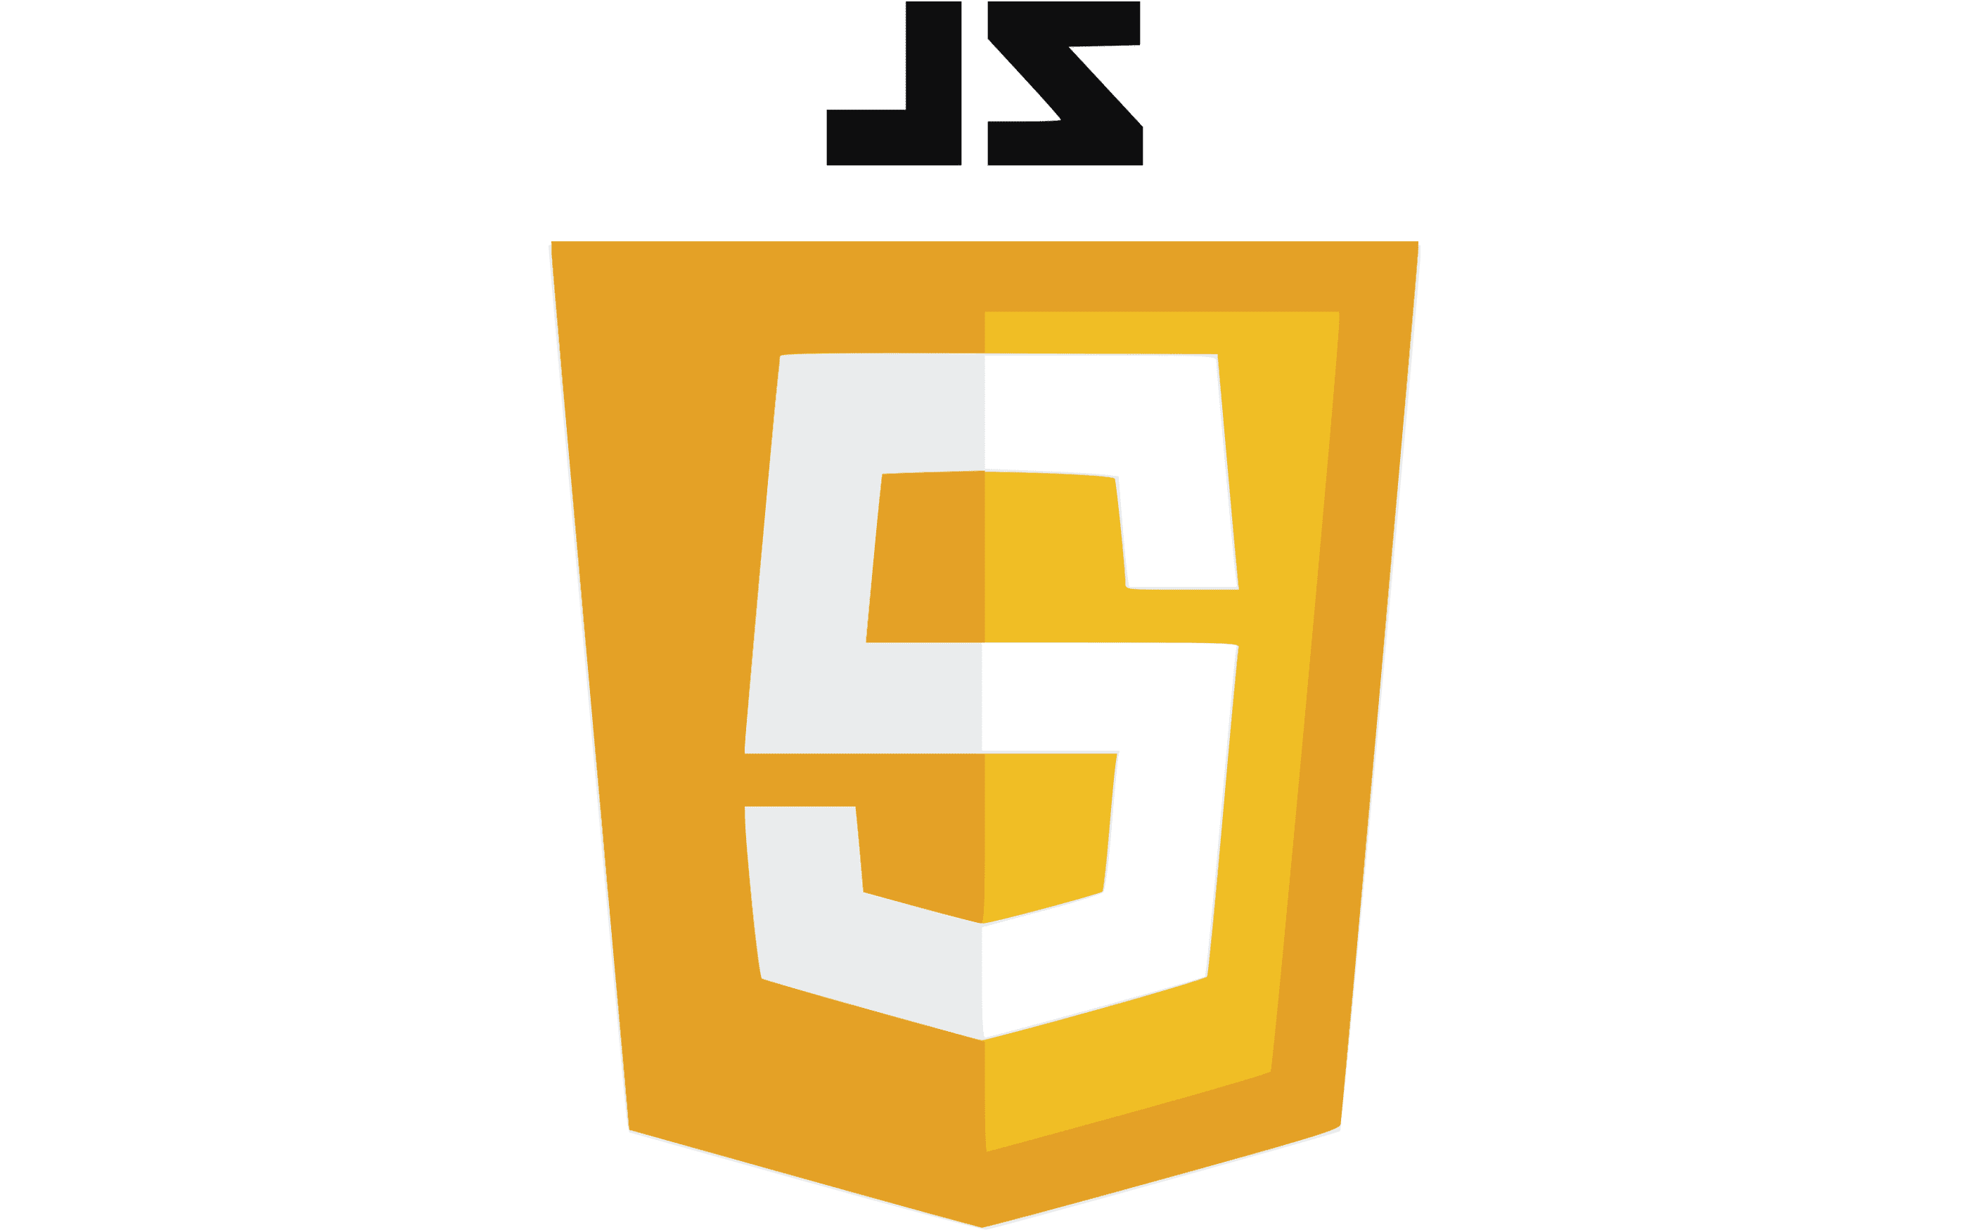
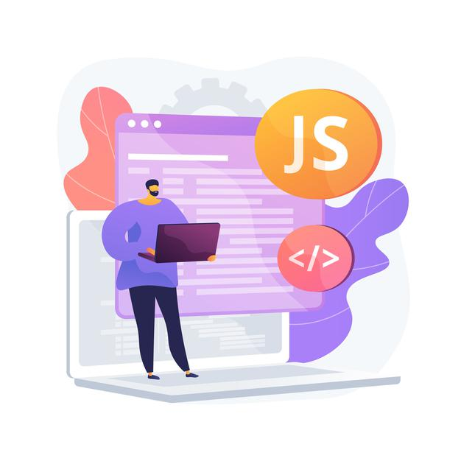
Introduction to JavaScript
JavaScript is the programming language of the Web.
JavaScript is the world's most popular programming language.
It is an asynchronous non-blocking IO language.
JavaScript is a text-based programming language used both on the client-side and server-side that allows you to make web pages interactive.
Client-side JS – When code runs on Browser.
Server-side JS – When the code runs on webserver, e.g. NodeJS
Where HTML and CSS are languages that give structure and style to web pages, JavaScript gives web pages interactive elements that engage a user.
???
What we can do with JS?
Why Study JavaScript?
JavaScript is one of the 3 languages all web developers must learn:
1. HTML to define the content of web pages
2. CSS to specify the layout of web pages
3. JavaScript to program the behavior of web pages
We can show output to the user
Change the CSS at runtime
Validate the data
Manipulate the DOM
Send server requests
Dynamically change and add Element on the screen

Slide 13
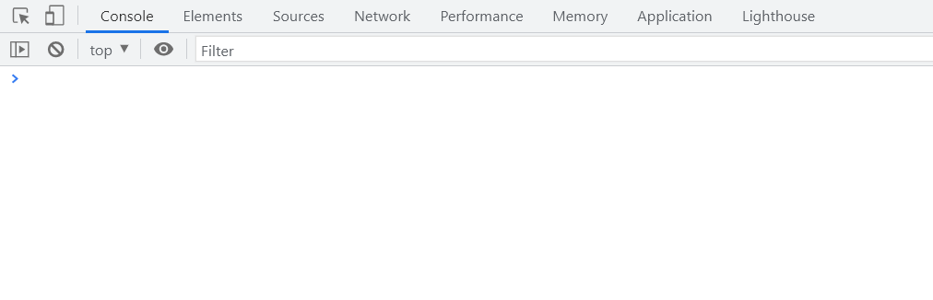
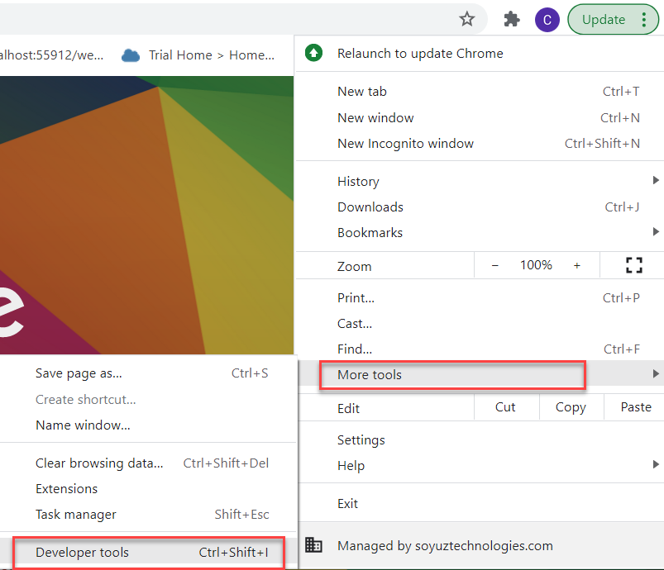
Creating the Variables in JS
In a programming language, variables are used to store data values.
JavaScript uses the keywords var, let and const to declare variables.
An equal sign is used to assign values to variables.
JavaScript variables are case sensitive.
Example: -
var x; var a = 10; let y; var b = ‘Hello World’;
How to access Console in the Browser.
We can access the console in the browser by pressing F12 on the keyboard.
On console we can execute the JavaScript commands, and we can also view the output over there.
We can also access the console form developer tools.

Slide 14

Exercise: JS Basics
Now we will see how to create variables in JS and what are the type of variables.
We will also perform some basic operations on the variables.
Exercise Code/Resources:-
- JSBasics

Slide 15

Some Important Point related to JavaScript
JS is case-sensitive (80% developers does case-sensitive errors)
Every statement in JS ends with semi-column
In JS = is an assignment operator, == and === are comparison operator, == compare only value and === compare data type also
We can declare variable in JS w/o any data type, based on the value assigned to the variable system auto determine the variable type, the keyword to declare variable is var.
JS Naming convention is camel case, the first letter of any word is small, next consecutive word’s first letter is caps.
Ex:-
iloveindia ➔ iLoveIndia
wearelearningJS ➔ weAreLearningJs
Methods to Apply JS in HTML
Inline JS – The script code is applied at html element level using events e.g., onclick, ondblclick, onhover, onkeypress. This is not recommended as its not reusable.
Internal JS – We write script code inside a script tag. We can use functions for that. There are 2 types of function. Which means it is reusable.
External JS – JS code is written in another file which has extension as .js. We will link it with our script tag. In the same way we linked CSS with link tag.

Slide 16
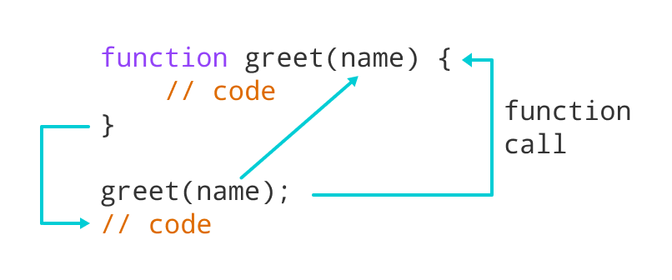
Function in JavaScript
Functions in JavaScript
A JavaScript function is a block of code designed to perform a particular task.
A JavaScript function is executed when "something" invokes it (calls it).
A JavaScript function is defined with the function keyword, followed by a name, followed by parentheses ().
The code to be executed, by the function, is placed inside curly brackets: {}
Function parameters are listed inside the parentheses () in the function definition.
Function arguments are the values received by the function when it is invoked.
Inside the function, the arguments (the parameters) behave as local variables.
Types of functions
Functions are of 2 types →
1. Anonymous function 2. Named Function
function(params) {
//code
}
function functionName(params) {
//code
}
JS also has 2 very powerful built-in/system variables which we can use out-of-box.
document = it is the object of DOM and can be used to access all the HTML elements on the page. The document object has so many reusable functions like getElementById, getElementsByClassName, getElementsByTagName
window = it is the object of our browser window

Slide 17
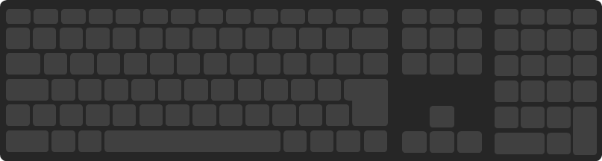
Exercise: Inline and Internal JS
Now we will see some example related to Inline, Internal and External JS
Design a login screen with login button. If user enter user and password SAME login user by changing DOM to login success. Else show an alert that username and password invalid.
Exercise code/resource: Inline and Internal JS
JSBasic.html

Slide 18
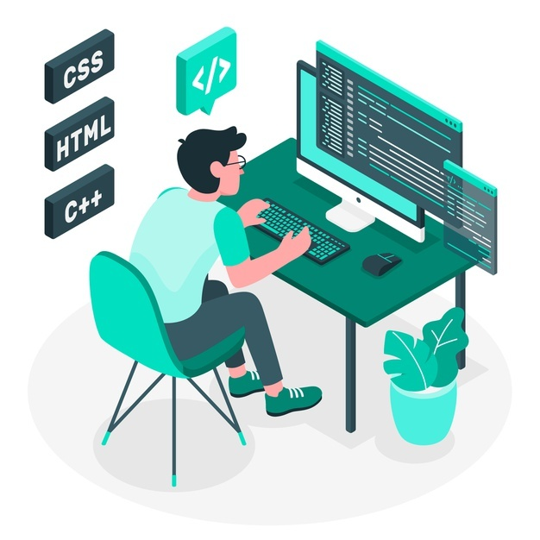
Exercise: External JS and Style change
Now we will move all our internal JavaScript code to a new file named mycode.js under a new folder named utils.
Along with that we will also see some examples of changing the style elements using the JavaScript.
Exercise code/resources:
JSBasic.html
utils
mycode.js
css
mystyle.css
For this example we have changed our class names to
some standard names in the mystyle.css file

Slide 19
Synchronous and Asynchronous Response
User
Screen
Server
Database
Save
Processing
Time
Request send to server
Request to Database
Synchronous Response
For all this time user
Remains blocked
Response form Database
Save
Request send to server
For all this time user
Remains blocked
Request to Database
Asynchronous Response
For all this time user
Is Not Blocked
Response from the server
Response form Database

Slide 20
Data Types of JavaScript
Data types in JavaScript describe the different types or kinds of data that you will be working with and storing in variables. It's important that you learn each of these data types because otherwise data can get stored in an improper format which will result in issues in your code later.
JavaScript Data Types
Primitive
Non-Primitive/Reference
String
Array
Object
Number
Boolean
Undefined
Null
Symbol

Slide 21
Arrays and Objects in JS
Array: An Array is a collection of data and a data structure that is stored in a sequence of memory locations. One can access the elements of an array by calling the index number such as 0, 1, 2, 3, …, etc. The array can store data types like Integer, Float, String, and Boolean all the primitive data types can be stored in an array.
Object: An Object is a non-primitive, structured data type in JavaScript. Objects are same as variables in JavaScript, the only difference is that an object holds multiple values in terms of properties and methods.
Syntax for object
var oObjName = { “prop”: value,
“prop”: value,
“prop”: value }
Syntax for Array
var aItems = [item0, item1,….]
Ex:
var myArr = [1, 2, 3, 4, 5];
var myArr2 = [‘a’, ‘b’, ‘c’];
Example of an Object
{
//this is an EntitySet of type object (single)
"empStructure": {
"empNo": 100,
"empName": "Latika Roongta",
"salary": 9000,
"currency": "EUR"
}
}
Java Script Object Notation – JSON
You can validate json using https://jsonlint.com
Elements or properties
Entity set

Slide 22
Exercise: Arrays and Objects
In this exercise we will create a JSON, and then will print the data in that json on the console on press of a button on the HTML page.
Exercise Code/Resource:
JSBasic.html
mycode.js

Slide 23
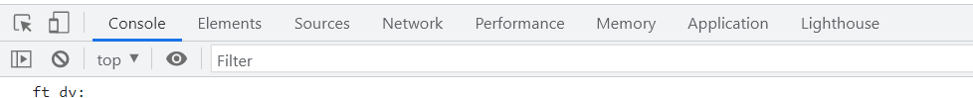
JavaScript Debugging Tools
Debugging is the process of detecting and removing of existing and potential errors (also called as 'bugs') in a software code that can cause it to behave unexpectedly or crash.
In order to debug JS code effectively, start the web app in a new tab/window, open F12 with option Sources tab. Set up the Break point by clicking on the line number.
Shortcuts for debugging are as below
Type | ABAP | JS
Step-in | F5 | F11
Step-out | F7 | Shift+F11
Go to next | F6 | F10
Continue (till Next BP) | F8 | F8
There are several tabs in the console, while working on the application we are mainly focused on Console, Elements, Source and Network Tab.
Console: It is the place where we run the JavaScript Code and Print the output for testing and Debugging
Elements: It shows the DOM of the current page open in browser.
Source: All the JavaScript code of the app or page will be visible here. We can also debug the code form here.
Network: We can see all the Network related calls made by the application in this section.

Slide 24

End of Day 2

Slide 25

Questions

Slide 26

Anubhav Oberoy

Slide 27


We’re committed to empower you to be
Most Desirable Resource
through powerful training solutions.
We build the workforce of the future.
250+
Corporate Clients
30,000+
Learners Trained
25000+
Learners Placed
FREE WEBINARS
Sign up for free webinars with industry experts every fortnight!
Enroll Now!
Contact us today!
https://anubhavtrainings.com/

Slide 28




More from AnubhavTrainings.com

Slide 29
Title
Content

